Slide 1

KESHAV MEMORIAL ENGINEERING COLLEGE A unit of Keshav Memorial Technical Educational Society (KMTES) (Approved by AICTE, New Delhi & Affiliated to Osmania University, Hyderabad)
DEPARTMENT OF COMPUTER SCIENCE & ENGINEERING
(CSE – C)
Mini Project Presentation on
DCTM: Diffusion-Based Cyber Threat Modelling for Improved Intrusion Detection Performance
by
Kasturi Vishnu Vardhan– 245523733160
Kukunuru Thrinadh Reddy –245523733163
Neha Sri Tirunagari – 245523733187
Guide:
Ms. Duddeda Aishwarya
Assistant Professor
Notes:
Good morning, we are Team 06, CSE-C
Project: DCTM — Diffusion-Based Cyber Threat Modelling
I'm Neha, teammate is Thrinadh
Guide: Ms. Duddeda Aishwarya

Slide 2
Index
Batch No. C6 DCTM
Abstract
Introduction
Problem Statement
Workflow
Architecture
Dataset
References

Slide 3
1.Abstract
Batch No. C6 DCTM
Machine learning-based Network Intrusion Detection Systems (IDS) remain highly vulnerable to adversarial traffic. While frameworks like DEMGAN utilize multi-generator Wasserstein GANs to achieve an average evasion rate of 97.42% on the CICIDS2017 dataset, they face three critical limitations: a restrictive feature set (limited to 10 features via Mutual Information), GAN-based instability that fails to generalize against linear classifiers, and severe class imbalance.
We propose DCTM : A Tabular Diffusion-based Adversarial Framework -introducing: (1) a Transformer-based Denoising Diffusion Model for stable generation, (2) SMOTE for class imbalance mitigation, and (3) MI + SHAP feature selection expanding to 20 attributes.
Evaluated on CICIDS2017 and CICIDS2018 with metrics: Evasion Rate, F1, Precision, and Recall.
Keywords: Adversarial Examples, Network IDS, Tabular Diffusion, Transformer, Feature Selection, SMOTE, CICIDS2017
Notes:
IDS = system that detects network attacks
DEMGAN (existing paper) = 97.42% evasion rate but 3 problems
3 problems: only 10 features, GAN unstable, ignores class imbalance
We built DCTM → fixes all 3
DCTM uses: Diffusion model + SMOTE + 20 features
Tested on 2 datasets, measured with F1 + Precision + Recall too

Slide 4
2. Introduction
Batch No. C6 DCTM
Modern networks face constant threats: DDoS, PortScan, SQL Injection, Brute Force, Botnets.
ML-based Intrusion Detection Systems (IDS) classify network flows as Benign or Malicious.
IDS models (DT, RF, MLP, CNN, etc.) perform well on benchmark datasets.
Problem: ML models are NOT robust to adversarial inputs - crafted samples that fool the classifier.
Adversarial Traffic: a malicious flow modified so the IDS labels it as "Benign" — this is an evasion attack.
To evaluate IDS robustness, security teams need adversarial generators.
DEMGAN (CMC, 2025) is the current state-of-the-art generator — uses Wasserstein GAN.
DCTM improves on DEMGAN using Diffusion Models — more stable, more comprehensive.
Dual-use: DCTM is both an attack tool (evasion) and a defense tool (adversarial retraining).
Notes:
Networks face attacks: DDoS, PortScan, SQL Injection etc.
IDS = ML model that labels traffic as Safe or Attack
Problem → attacker can craft fake "safe-looking" traffic → IDS gets fooled
This is called an evasion attack
We need tools to test how easily IDS gets fooled
DEMGAN does this with GAN → we do it better with Diffusion
Our tool works both ways → attack IDS AND strengthen it

Slide 5
3.Problem Statement
Batch No. C6 DCTM
Gaps in Existing Work:
ML-based IDS vulnerable to adversarial traffic — core threat unresolved
DEMGAN limited to 10 features — 69+ informative features ignored
GAN training instability produces low-quality adversarial samples
Mode collapse reduces diversity of generated attack traffic
Class imbalance in dataset ignored — rare attacks underrepresented
Evaluation limited to evasion rate — no F1, Precision, or Recall
Our Solution:
Replace GAN with Tabular Diffusion Model — eliminates instability and mode collapse
Expand feature selection to 20 using MI, SHAP.
Apply SMOTE to handle class imbalance before model training
Extend evaluation to F1-score, Precision, and Recall
Notes:
Gaps (what's wrong with DEMGAN):
Only 10 features used → too limited
GAN is unstable → bad on Decision Tree and Logistic Regression
Rare attacks ignored → Heartbleed has only 11 samples
Only evasion rate measured → no F1, Precision, Recall
Our fix:
Replace GAN → Diffusion model (stable)
10 → 20 features using MI + SHAP
SMOTE → fixes class imbalance
Add F1, Precision, Recall to evaluation

Slide 6
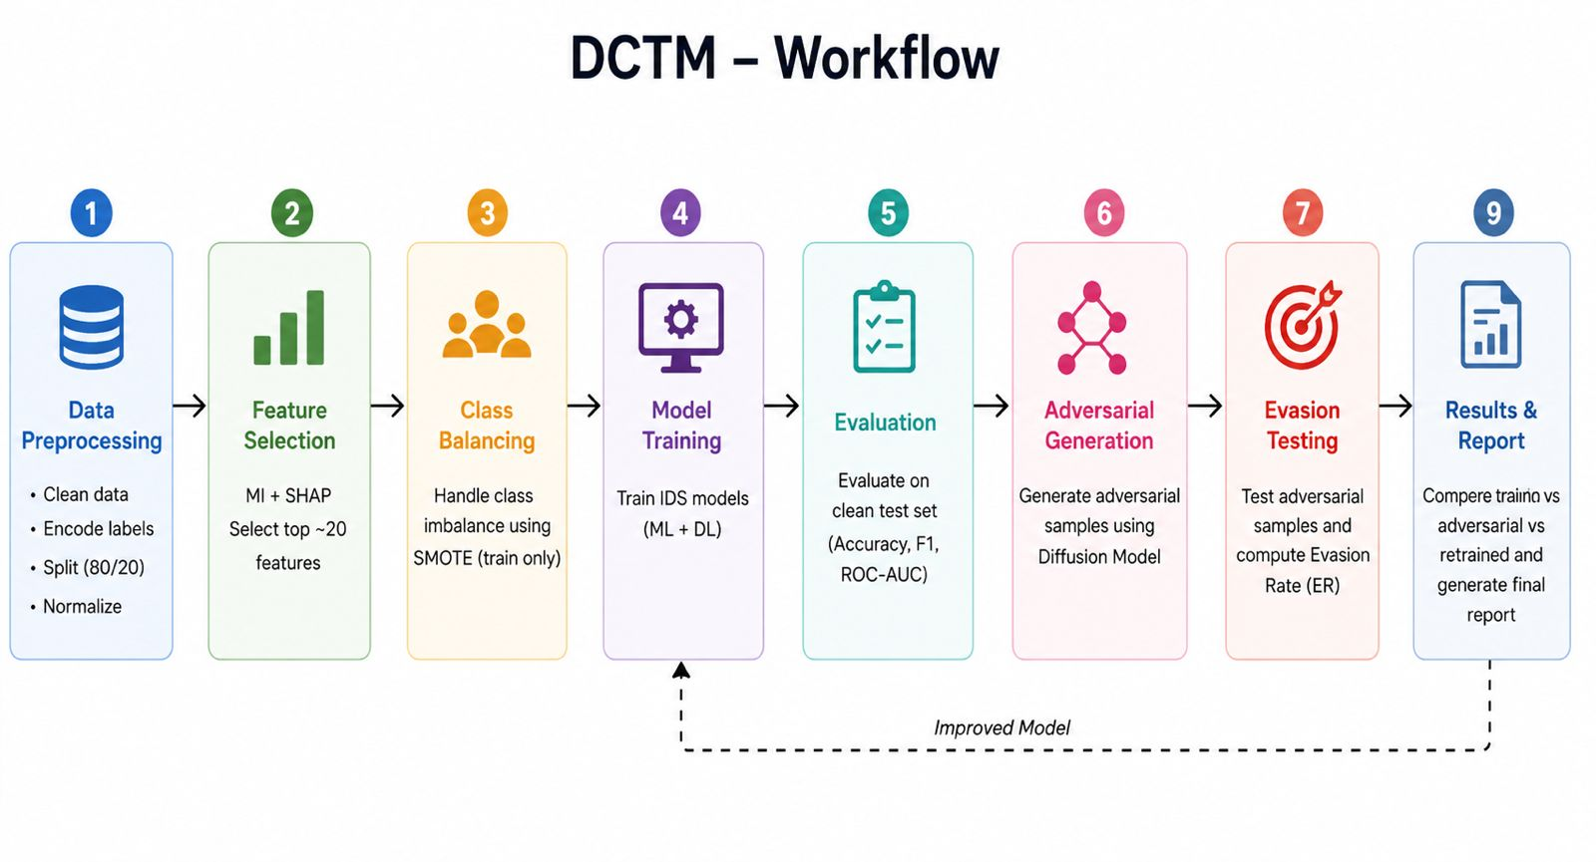
4.Workflow
Batch No. C6 DCTM
Notes:
Start: raw CSV files (CICIDS2017 dataset)
Step 1: clean data → remove bad rows → normalize to 0-1
Step 2: pick top 20 features using MI + SHAP combined
Step 3: SMOTE → balance rare attack classes → train 10 IDS models
Step 4: train Diffusion model per attack class
Step 5: generate adversarial samples → test on IDS → measure evasion rate
End: retrain IDS with adversarial data → IDS becomes stronger

Slide 7
5. Architecture
Batch No. C6 DCTM
Architecture

Slide 8
6.Dataset
Batch No. C6 DCTM
CICIDS2017
Source: Canadian Institute for Cybersecurity (CIC), UNB
Size: ~2.83 million samples after data cleaning
Columns: 79 network traffic features
Attack categories: 14 types (DoS, DDoS, PortScan, Bot, XSS, SQL Injection, etc.)
Used in: DEMGAN (base paper) — primary evaluation dataset
CICIDS2018
Source: CIC & Communications Security Establishment (CSE), UNB
Size: 2M+ samples (partial selection used for experiments)
Columns: 79 network traffic features
Attack categories: DoSHulk, Bot, SlowHTTPTest + Benign
Used in: DEMGAN (base paper) — generalization/universality testing
Notes:
CICIDS2017:
2.83 million samples, 79 features, 14 attack types
Main training + evaluation dataset
Same dataset used in DEMGAN
CICIDS2018:
2M+ samples, 4 attack types
Only for generalisation testing → never used in training

Slide 9
7.References
Batch No. C6 DCTM
DEMGAN: A Machine Learning-Based Intrusion Detection System Evasion Scheme.2025. (Base Paper)
Wasserstein GAN. 2017.
Identifying Relevant Features of CSE-CIC-IDS2018 Dataset for the Development of an Intrusion Detection System. 2023 .
SMOTE: Synthetic Minority Over-sampling Technique. 2002.
Notes:
DEMGAN 2025 → base paper we are improving
Wasserstein GAN 2017 → what DEMGAN was built on
SMOTE 2002 → for class balancing
CICIDS dataset paper → dataset we used

Slide 10
End of Presentation
Batch No. C6 DTCM
Thank You
Open to Questions & Suggestions

